Slide 1
Standard Template Library - I
by
Tenneti Venkata Suresh(159231)
Foundation TEG
18 November 2013

Slide 2
Standard Template Library
Overview
Containers
Iterators
Algorithms

Slide 3
Overview
The STL (Standard Template Library) was developed by Alexander Stepanov and Meng Lee at Hewlett-Packard
STL was designed for performance and flexibility
The STL is basically a library defining different structures and routines in an object oriented paradigm.
Implemented using the templates.
The STL offers proof of concept for generic programming with templates.
The STL approach allows for generic programming where the code does not depend on the underlying container.

Slide 4
Overview
STL is composed of three key components
  Containers are data structures capable of storing objects of any data type.
  Iterators are similar to pointers to access and manipulate the elements of the containers.
  Algorithms are functions that perform common data manipulations as searching, sorting and comparing elements.

Slide 5
+
Clear demarcation of the containers and routines.
Efficiency
  STL containers are very close to the efficiency of hand-coded, type-specific containers. The reason for this is they are implemented using the templates.
Flexibility
  The use of generic algorithms allows them to be applied to many different structures.
  STL's generic algorithms also work on native C++ data structures such as strings and vectors.

Slide 6
-
Little learning curve is outweighed by the advantages.
Needs understanding of programming using templates.
Code readability is a little low.
                Containers
A container is a holder object that stores a collection of other objects.
Containers manage the storage space and provide member functions to access them directly or through iterators.
Containers replicate the structures commonly used in programming as arrays(vectors), queues(queue), stacks(stack), heaps(priority_queue), linked lists(list), trees(set) and associative arrays(map)

Slide 7
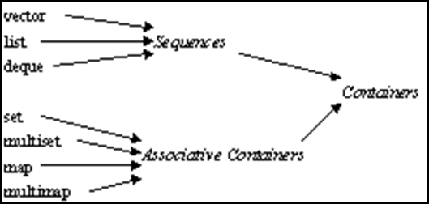
Containers
Sequence containers
      vector
      deque
      list
Container Adaptors
      stack
      queue
      priority_queue
Associative Containers
      set
      multiset
      map
      multimap

Slide 8
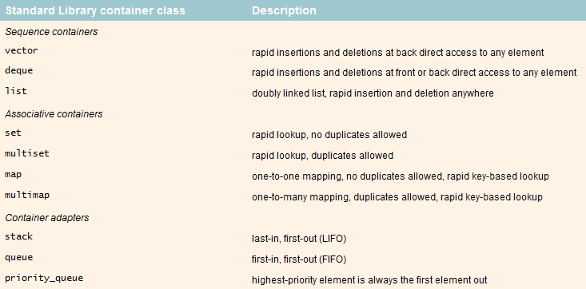
Containers

Slide 9
Containers
Sequence containers (Linear data structures)
  Containers that hold objects in a sequence.
Container adaptors
  Classes/objects that hold other container objects and provide a specific interface irrespective of underlaying container object
Associative containers (Non-linear data structures)
  Objects that hold elements that hold a relationship (key-value) between them

Slide 10
Containers
All the containers support the (minimal) functionalities like default constructor, copy constructor, destructor and assignment operators and comparison operators like operator==, operator!=.
The containers provide the simple iterators and functions like erase() and clear().
All the generic operations like search, sort, find and others are relegated to algorithms.

Slide 11
Vectors
Vectors are composed of a single block of sequential memory, just like C arrays.
Though similar to C arrays, vectors can grow dynamically as it reaches its capacity.
Capacity is the total number of elements that can be added to a container (here vector) before it needs to regrow itself.
Size is the number of elements that are currently hold by the container. Refer program vectors.cpp
The capacity doubles as the size reaches the capacity.
Insertion/removal at the end is efficient. Other positions is costly.
Memory is released when the vector object is destroyed.

Slide 12
Vectors
Implementation requirements for template typename T :
T(); //constructor
T(const T&); //copy constructor
~T(); //destructor
T& operator=(const T&); //assignment operator
Drawback: Overflow condition can cause a complete copy.
  The vectors grows itself when its capacity is reached.
  This needs allocation of memory at a new location and copy the elements from the old location to the new location.
  This is an expensive operation when class objects are involved as it calls the destructor and constructor for each object.

Slide 13
Vectors
push_back() : Adds element at the end.
pop_back() : Deletes last element
insert() : Inserts elements
erase() : Erase elements at the given index
clear() : removes all elements
size() : returns the size
capacity() : returns the capacity
operator[] : access element at the index
reserve() : change the capacity
begin() : returns iterator to beginning
end() : returns iterator to the end
vector<T>::iterator - Random access iterator to value_type T
vector<T>::const_iterator - Random access iterator to const value_type T

Slide 14
Deques
Deques are double ended queues.
Though similar to the vectors, the internal implementation is completely different. Memory is not allocated contiguously.
Hence elements cannot be accessed by pointer offsets.
Elements can be added and removed at either ends. This is where the deques primarily differ from the vectors.
push_front() : Adds elements to the front of a deque
pop_front() : Removes elements from the front of a deque

Slide 15
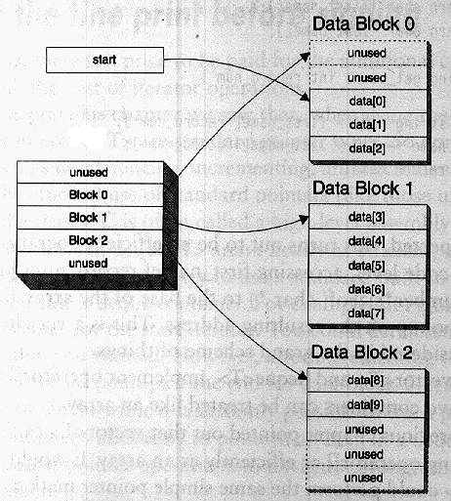
Deques
Concepts of capacity() and reserve() are not applicable.

Slide 16
Iterators
Iterators are the reference objects with similar properties to pointers. Pointers are the most obvious form of iterators.
They are similar to the pointers in C.
The iterators can be dereferenced using the * operator.
The iterators support atleast the increment operator (++) to iterate through the range; and few others.
Each of the STL containers provide the iterators specific to their type; and can be retrieved through member functions.
            vector<T>::iterator iter = intVec.begin();

Slide 17
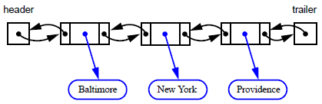
lists
Lists are composed as doubly linked lists.
Best to use when objects are inserted/removed anywhere in the list.
Search is an expensive operation.

Slide 18
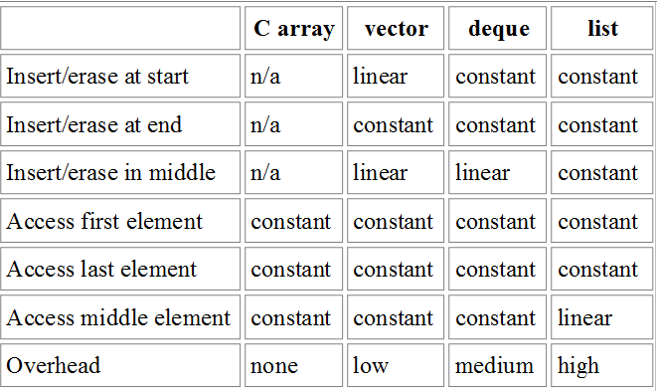
Comparison of sequence containers

